Slide 1

Prompt engineering 2025
K. PRAKASH SENAPATI

Slide 2
Agenda
My introduction
What Is prompt engineer ?
complete roadmap to learn prompt engineer ?
PROMPT CREATION USING python basic code
prompt ENGINEERING CODE USING OPENAI, STREAMLIT
UPCOMING TRAINING BATCH & GENERATIVE AI VIDEOS
SCAN QR CODE & POST YOUR QUERY
Q & A

Slide 3
What Is prompt engineer ?
Prompt engineering is the process of structuring an instruction that can be interpreted and understood by a generative artificial intelligence (AI) model.
Imagine you have alexa, Siri or Google Assistant. This smart robot can do many things, like answering questions, writing stories, or giving recommendations. But, just like any smart assistant, it only does what you ask it to do.
Prompt engineering is the technique to figuring out the best way to ask the generative AI (like ChatGPT) to get exactly what user need. It’s like being a good communicator with the ai so it can give you the best possible response.
A prompt engineer is someone who designs and optimizes prompts to guide AI models to generate desired responses
A prompt is natural language text describing the task that an AI should perform.

Slide 4
complete roadmap to become prompt engineer ?
1- Prompt engineer technique
2- llm model & know about api key
3- Generative ai
4- Deep learning & neural network
5- nlp
6- Python programming language

Slide 5
Let’s code to build prompt
1- PROMPT CREATION USING python basic code
2- prompt ENGINEERING CODE USING OPENAI, STREAMLIT

Slide 6
GENERATIVE AI PREVIOUS RECORDING SESSION
1- ChatGPT Tutorial for Developers | Introduction to ChatGPT → youtube.com/watch?v=SDStCnlITT8
2- Generative AI Workshop → youtube.com/watch?v=Xp1MnygECUs
3- LARGE LANGUAGE MODEL → youtube.com/watch?v=v0w9LXXrsys
4- COMPLETE DATA SCIENCE LIBRARY → youtube.com/watch?v=MsFhUjFL4vE&t=209s
5- Know About Data Science & Generative AI→ youtube.com/watch?v=TR_OCx5z-m8
6- Generative AI with Langchain, Langsmith, OpenAI & LLMops → youtube.com/watch?v=MAkXifYHnuw&t=1320s
7- Google Generative AI | Gemini AI→ youtube.com/watch?v=BDrXdvNh19Q&t=5684s
8- Gen AI for Build LLM Model Using Lama 3,Hugging Face & Ollama : youtube.com/watch?v=eDN6fAWLNNE&t=5425s
9- GEMMA-9B Integration with GROQ, HUGGINGFACE & LANGCHAIN: youtube.com/watch?v=Bp1XyvMvedg&t=7086s
10- NLP: youtube.com/watch?v=s-xhKH-e8ig&t=5844s
11- RAG: www.youtube.com/watch?v=8nWjvn8ZKtU&t=7553s
12- CREW AI: https://www.youtube.com/watch?v=0gqlrw-6I0s
13- STABLE DIFFUSION : https://www.youtube.com/watch?v=c1GqJ-VFLW0
14- STATISTIC : https://www.youtube.com/watch?v=baJi1276DcU&t=1288s
15- why to choose fsds with Genai ( llama 3.2 model) : https://www.youtube.com/watch?v=UgFerJcuICw
16- prompt engineer: https://www.youtube.com/watch?v=2n-RIgSNnwQ&t=8628s

Slide 7


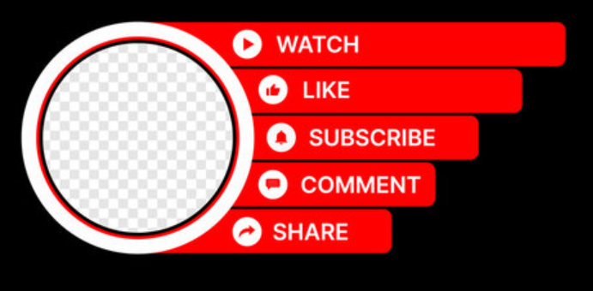
RESUME BUILDING BOOTCAMP
DAY-1 (2nd Oct) → https://www.youtube.com/watch?v=aPPlQpwRIBg&t=831s
DAY-2 (3rd Oct) → https://www.youtube.com/live/B3L5UJx3wzk
DAY-3 (4th Oct) →
https://www.youtube.com/watch?v=ALc1RZ2m2sM

Slide 8
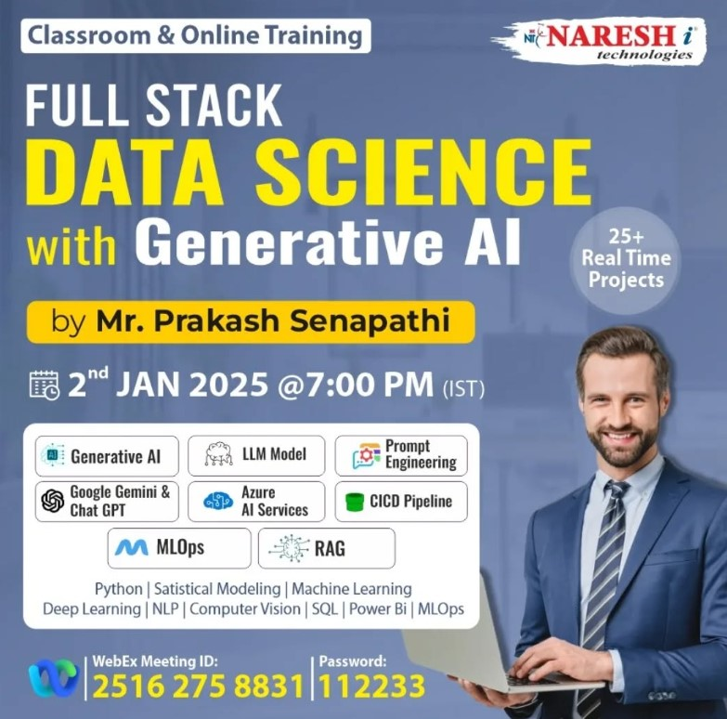

Slide 9

Thank you
K.PRAKASH SENAPATI
KODIDATASCIENTIST@GMAIL.com
https://nareshit.com/
https://www.linkedin.com/in/kodi-prakash-senapati-a95a60182/

